Slide 1
DOELAP External Dosimetry Training Travel Topics
Idaho Falls, ID
September, 2023

Slide 2
Travel Contacts
Lisa Pardonnet
pardonla@id.doe.gov
(208) 716-0808
1955 Fremont Ave.
MS 1240
Idaho Falls, ID 83415
Tina Wagoner
wagonetl@id.doe.gov
(208) 526-0423

Slide 3
Funding for Assessor Travel
DOELAP reimburses travel expenditures that are considered customary and necessary for the completion of duties.
If you mix business and pleasure travel, you must get approval from STM and get a theoretical estimate of costs for DOELAP travel vs. costs for travel including personal dates
Driving POV vs. flying
Reimbursement for lesser of the two
The traveler pays the difference between the theoretical DOELAP-only dates travel fare and the cost for the dates of personal travel or POV
Also extra hotel nights, fuel, etc.

Slide 4
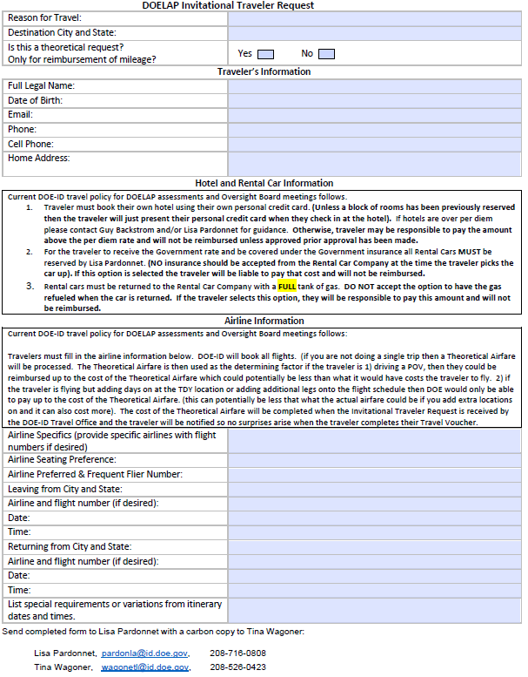
DOELAP Invitational Traveler Request

Slide 5
Travel Requests
Lead assessor coordinates with other assessors (and site if desired) to choose an appropriate hotel.
Travelers should make all efforts to get government per diem rate
If government rate is unavailable, over per diem may be authorized
Lisa and Tina need to have hotel price per night prior to completing the travel authorization (over per diem must be approved in advance)
Travelers are responsible to make their own hotel reservations
Lisa/Tina make rental car and flight reservations
Identify taxi, uber, POV mileage (both ways), airport parking, etc. for transportation between home and airport
The sooner the better

Slide 6
Rental Car/Local transportation
One car per team
Rental car typically is reserved under Lead Assessor’s name, but be sure to let Lisa/Tina know who should be assigned
Travelers must use the LEAST expensive compact car available
If more than 2 assessors are going a larger car may be justified
Indicate assessment duration
Submit justification for rental car
Basic justification (1 car per team, travel between hotel and site)
If possible, identify any known airport, hotel, or other parking fees that will be necessary

Slide 7
Rental Car/Local transportation
Identify receipts for
Rental car gas
Shuttle to/from airport
Taxi to/from airport
Travelers will NOT be reimbursed for purchasing pre-paid refueling options. Travelers should refuel prior to returning an approved rental vehicle
Taxi for meals is not reimbursable

Slide 8
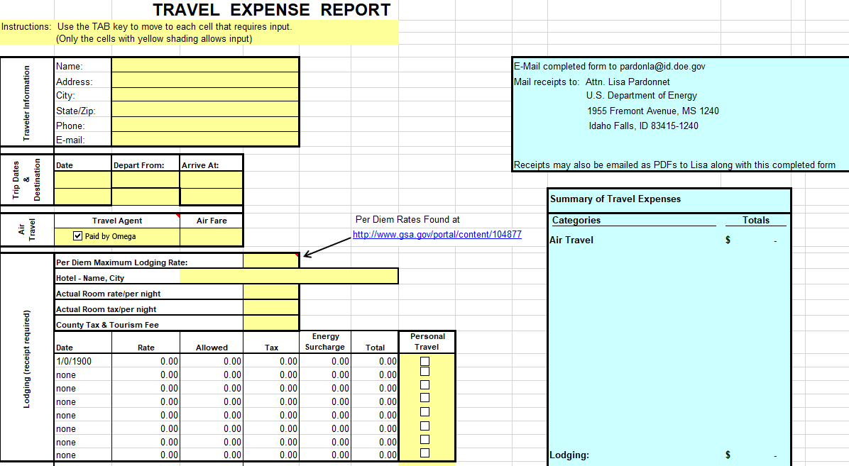
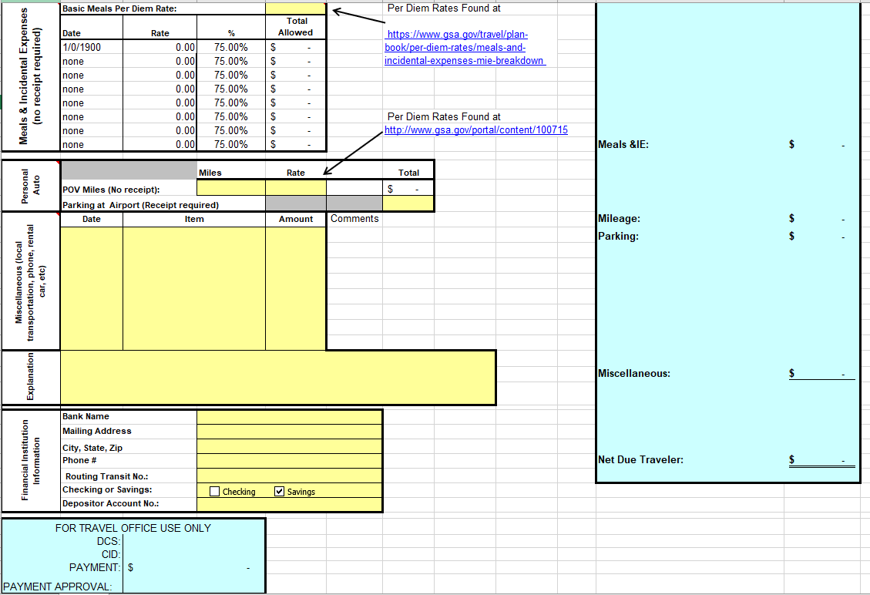
DOELAP Travel Expense Report

Slide 9
When Travel Goes Wrong
Personal issues
Flights delayed/cancelled
Rental car accident
Other issues?

Slide 10
Questions?

